Slide 1

CSE 583
Software Design for Data Scientists Course Introduction & validating software
Bryna Hazelton^{1,5}, David Beck^{1,2,3,4},
Elli Beres^{3,6}, Ian Quah⁷
¹eScience Institute
²Chemical Engineering
³Computer Science
⁴Environmental & Occupational Health Sciences
⁵Physics
⁶Seattle Hub for Synthetic Biology,
⁷Psychology
University of Washington
October 9, 2025

Slide 2
git add
git commit
git push
Working directory
staging area (index)
local repository:
snapshots
remote repository:
snapshots
git merge
git fetch
git pull
git status: use frequently to understand where files & code changes are in this process

Slide 3
Hands on practice

Slide 4
making changes
Check the status
use git status to see what things have changed
use this command liberally — it’s always safe and helps you know what’s going on
Identify all the changes you want to snapshot together
use git diff to see what the changes are
use git add <file> to move changes to the staging area
only include changes that go together
make the snapshot
use git commit to make the snapshot: brings up a browser to add a commit message
or git commit -m ‘your message here’
commit messages should be descriptive
view the history
git log, git show
Notes:
talk through the way git fundamentally thinks
purpose of the staging area is to make it possible to only commit some of the local changes

Slide 5
syncing with the remote
get snapshots from the remote
use git fetch to get the snapshots but not apply them to the local repo
use git status to see differences between the local and remote
use git merge to apply the snapshots to the local repo
git pull is git fetch immediately followed by git merge but doesn’t let you examine the snapshots before applying them
send your snapshots to the remote
use git push to send your local snapshots to the remote
git will not let you push if there are snapshots on the remote that you have not yet merged into your local repository
view the history
git log, git show
Notes:
in order to push, you have to have all the remote changes

Slide 6
Collaborating with git: Branches
Scenario
Main development trunk of codebase
Bug comes in via issue report on GitHub
You need to work on the bug but don’t want to screw up main development trunk
What to do?
Notes:
Delineate git vs GitHub: version control vs collaborative tools

Slide 7
Collaborating with git: Branches
Main
Notes:
Delineate git vs GitHub: version control vs collaborative tools

Slide 8
branching
create a new branch and switch to it
use git checkout -b <branch_name> to create the branch and switch to it
for existing branches, use git checkout <branch_name> to switch to that branch
make changes and snapshots on that branch
push the branch up to the remote
use git push --set-upstream origin <branch_name> to make a branch on the remote that tracks your new local branch
make more changes and snapshots and push/pull
to merge the branch into the main, make a pull request
leads to a code review

Slide 9
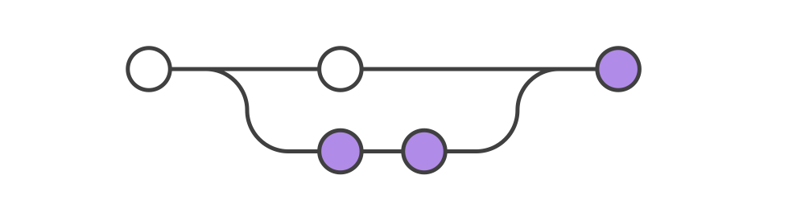
Merging (via Pull Requests)
Notes:
Delineate git vs GitHub: version control vs collaborative tools

Slide 10
Hands on practice

Slide 11
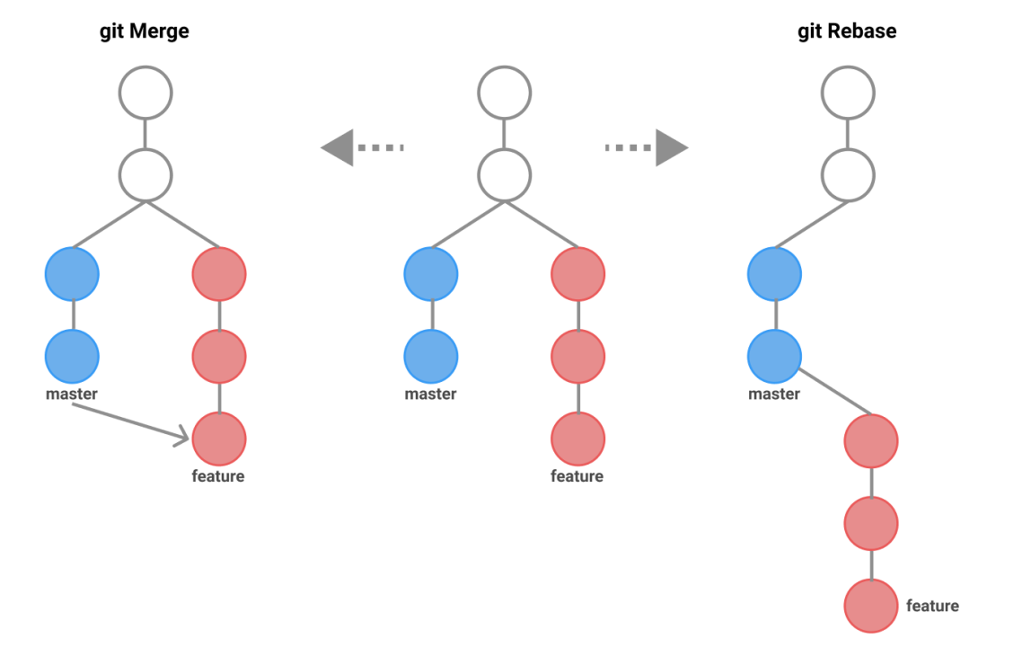
Merging vs rebasing
main
main
main
Notes:
Delineate git vs GitHub: version control vs collaborative tools

Slide 12
merging vs rebasing branches
merging in branches is straightforward, but can result in a somewhat complicated graph
rebasing is an alternative approach that results in a neat, linear graph at the expense of rewriting history
rebasing effectively moves the location that a branch leaves the tree
can be used to place branches at the tip of the master branch to avoid having to merge
effectively replays the changes in the branch after the end of the master branch

Slide 13
Collaborating with GitHub

Slide 14
Collaborative coding and data analysis
Issues and discussions
Keep track of TODOs and worries
Use labels!
Communicating with collaborators, including non-coding ones (advisors)
Threaded logbook linked to code (e.g. https://github.com/EoRImaging/FHD/issues/39)
Can embed plots, images as appropriate
Notes:
show FHD discussion

Slide 15
Collaborating on code
Branching workflow
make a branch for a specific topic
you can have multiple branches!
Pull Requests for code reviews (e.g. https://github.com/RadioAstronomySoftwareGroup/pyuvdata/pull/1292)
linking to issues
GitHub Milestones/Projects
track sets of issues towards a larger goal
Notes:
continuous integration
templating
changelog

